Slide 1

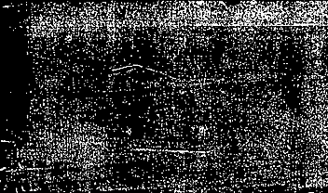

Software Engineering CS411, FALL 2025
Lecture 8: Design Principles II by Dr. Mohamad Kassab
Leonidas Kontothanassis kthanasi@bu.edu

Slide 2

Lesson plan
GRASP Patterns:
Expert
Creator
Controller
Low Coupling/High Cohesion
Polymorphism
Pure Fabrication
Indirection
Don’t Talk to Strangers (Law of Demeter)
we will focus on these three patterns in this lecture

Slide 3

CONTROLLER PATTERN

Slide 4
Controller
Intent:
Assign the responsibility for handling a system event to a class representing one of the following choices:
An object whose name reflects the use case.
<UseCaseName>Handler
An object whose name reflects the overall system, business, or large-scale entity.
A kind of “façade” object.
An object whose name reflects something in the real-world involved in the task.
A role controller
Notes:
Represents a use case scenario within which the system event occurs…
Represents the overall system, device, or subsystem
A controllers is a non-user interface object responsible for receiving or handling a system event. A controller defines the method for the system operation.
Examples: A PlaceOrderHandler for case 1, SystemHandler for case 2, UserXController for each user type x

Slide 5
…Controller
Problem:
Who should be responsible for handling input system events?
An input system event is a high-level event generated by an external actor; it is an external input event.
Notes:
An input system event is an event generated by the external actor. They are associated with system operations (operations of the system in response to system events), just as messages and methods are related.
Example: cashier using POS terminal presses “end sale” – a system event is generated indicating “sale has ended”. Or writer using word processor presses “spell check” button, system event indicating “perform spell check” is created.

Slide 6
Controller – Example…
In POS app, there are several system operations.
Who should be responsible for the system events?
Notes:
It is a controller or coordinator. It does not normally do the work, but delegates it to other objects. The controller is a kind of façade onto the domain layer from the interface layer.
enterItem is the system event message – who Is the “controller” for enterItem?

Slide 7
…Controller – Example…
By Controller pattern, choices are:
POST – overall “system”
Store – overall business/organization
Cashier – real-world entity involved in task
BuyItemsHandler – artificial handler of all system ops of a use case
Notes:
Here are the 4 choices

Slide 8
…Controller – Example…
The appropriate choice is dependent on other factors (coupling and cohesion) but some guidelines are:
Use façade controllers when there are only a few system events, or it is not possible to redirect system event messages to alternating controllers, such as in a message processing system.
UseCaseHandler is good choice when there are many system events across different processes and façade controllers would become “bloated”
Use role controllers sparingly. It is easy to assign all the work to person-like objects; instead, delegate.
Note: Presentation layer does not handle system events.
Notes:
The facade controller represents the overall system. The idea is that some class provides the main point of service calls from the other layers of the application and that provides the main point of service calls from the UI layer down to other layers
“bloated” – a single controller class receiving all system events
A controller should delegate to other objects the work that needs to be done; it coordinates or controls the activity. It does not do much work iteself.
An important corollary of the controller patter is that interface objects (presentation layer) should not have responsibility for handling system events.

Slide 9
Notes:
On the right: a window displays sale information and captures cashier operations. Using the controller pattern, an acceptable relationship is shown between the applet and :POST (register) and other objects in a portion of the POS system. Notice that the Applet class passes the enterItem message to the POST (register) object. It did not get involved in processing the operation or deciding how to handle it; the window only delegated it to another layer. Placing system operation responsibility in a domain object controller makes it easier to reuse the program logic supporting the associated business process in future applications. It also makes it easier to unplug the presentation layer and use a different interface framework or technology, or run the system in an offline batch mode.
On the Left: (The business logic is embedded instead of it sending a message to delegate that responsibility. ) assigning the responsibility for system operation to objects in the application or domain layer – using the Controller pattern rather than the inerface layer supports increased reuse potential. If the presentation layer object (applet) handles a system operation – which represents part of a business process – then business process logic would be contained in an interface object, which has low opportunity for reuse because of its coupling to a particular interface and paplication.

Slide 10
Controller
Consequences:
Increased potential for reusable components
Allows reasoning about the state of the use case
if UseCaseHandler used for all system events pertaining to that use case, it’s possible to ensure system operations occur in legal sequence.
Notes:
Ensures that application logic is not handled in the “presentation” layer. A presentation as controller design reduces the opportunity to reuse logic in future applications, since it is bound to a particular interface.
For example, it may be necessary to guarantee that the makepayment operation can not occur until the endsale operation has occurred. If so, this state information needs to be captured somewhere; the controller is one reasonable choice, especially if the same controller is used throught the use case (recommended).

Slide 11
Controller Summary
When to Introduce a New Controller Class
Use-case driven systems: If you have a large set of system operations tied to a single use case (like “Process Sale”), creating a dedicated controller class (ProcessSaleHandler) keeps those responsibilities grouped.
Separation of concerns: If no existing domain class is a good “face” for the system, a separate controller isolates the system interaction layer from the domain layer.
Future flexibility: If you anticipate system event handling logic will expand (authentication, logging, validation), a dedicated controller prevents polluting domain classes.
Multiple entry points: If multiple UI elements or devices trigger the same system operation, a controller class provides a stable, centralized handler. Preserve flexibility in case operation triggered by UI changes down the road.
When to Use an Existing Class
Representative domain class exists: If the system event clearly belongs to a conceptual domain object that represents the system or a major subsystem (e.g., Register in a POS system), it’s reasonable to let that class act as the controller.
Keeps model simple: If the system is small and adding a separate controller would only add unnecessary indirection, giving the responsibility to an existing class keeps things lean.
Tight semantic match: If the operation really is the responsibility of that domain object (e.g., Sale.addLineItem() being initiated through Sale itself), then creating a separate controller adds no value.
Notes:
Discuss the controller code here.

Slide 12
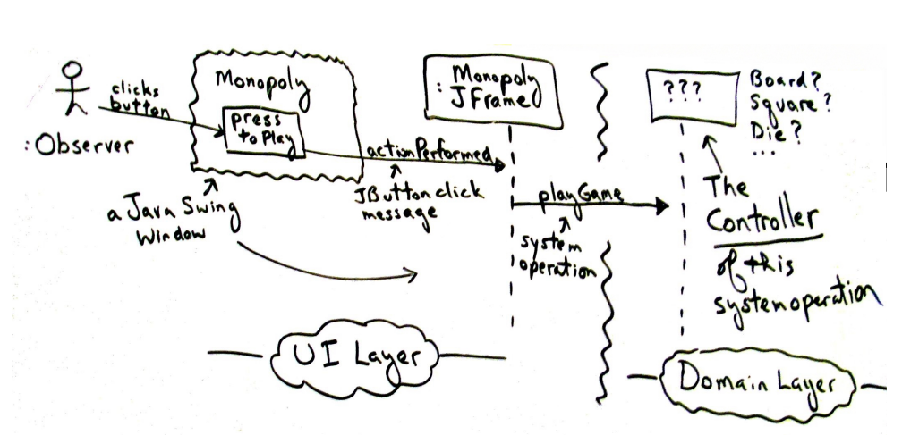

Slide 13

LOW COUPLING AND HIGH COHESION

Slide 14
Low Coupling
Intent
Assign a responsibility so that coupling remains low
Problem
How to support low dependency and increased reuse

Slide 15
Low-Coupling – Example…
In POS app, need to create Payment instance and associate it with Sale.
What class should be responsible for this?
Two choices:
Register records Payment so it is a candidate
Payments are associated with Sales so Sale is a candidate
Payment
Register
Sale

Slide 16
…Low-Coupling – Example…
Which supports Low Coupling?
Register creates Payment
Sale creates Payment
makePayment()
:Register
1: create()
p : Payment
2: addPayment(p)
:Sale
makePayment()
:Register
1: makePayment()
:Sale
1.1. create()
:Payment
Notes:
The register instance could send an addpayment message to the sale, passing along the new payment as a parameter.
This assignment of responsibilities couples the register class to knowledge of the payment class
second solution sale creates payment

Slide 17

Low Coupling
Consequences:
Not affected by changes in other components
Simple to understand
Convenient to reuse
Notes:
Sale must be coupled to knowledge of payment
First design adds coupling of register to payment – adds coupling of register to payment
Second design which the sale does the creation of a payment does not increase the coupling
Design 2 is preferable because overall lower coupling is maintained.
This is an example where two patterns - Low coupling and creator may - suggest different solutions

Slide 18
Example: Domain Model Diagram
Records-sale-of
Described-by
1
Product
Product
Specification
Catalog
Contains
1
1..
*
description
price
1
UPC
0..1
*
Used-by
Describes
Sales
*
*
LineItem
Store
Item
Stocks
quantity
1
address
1
*
1
*
name
1..
Contained-in
Logs-
1
Houses
completed
*
1
6
1..
Sale
*
register
Started-by
Manager
date
1
1
Captured-on
time
1
1
1
1
Initiated-by
1
Paid-by
3
Records-sales-on
1
1
1
Payment
Customer
Cashier
amount
Notes:
Multiplicity – defines how many instances of class A can be associated with class B
Single instance of store can be associated with “many” (zero or more, indicated by the *) Sale instance

Slide 19
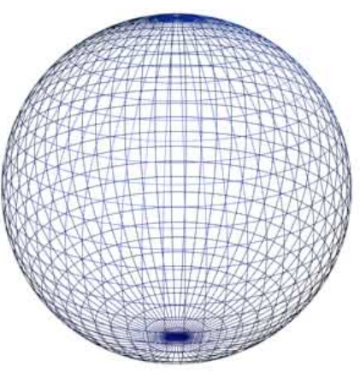
High Cohesion…
Intent:
Assign a responsibility so that cohesion remains high
Problem:
How to keep complexity manageable
In OO, cohesion is a measure of how strongly related and focused the responsibilities of a class are
Notes:
Cohesion – is a measure of how strongly related and focused the responsibilities of an element are
An element with highly related responsibilities and which does not do a tremendous amount of work, has high cohesion

Slide 20
High Cohesion – Example…
Examine previous example for high cohesion.
We need to create Payment instance and associate it with Sale.
What class is responsible?
Register records Payment so Creator suggests Register for creating Payment. Register could then send addPayment message to Sale, passing Payment as parameter.
makePayment()
:Register
1: create()
p : Payment
2: addPayment(p)
:Sale
Notes:
Everything is strongly related –
If we have a cash payment instance and associate it with sale – register records payment – register could send addpayment message to sale with payment as the paremter
This is ok for an isolated example.

Slide 21
…High Cohesion – Example…
This is acceptable, but if we continue to make register class responsible for doing some or most of the work related to more and more system operations, it may become overworked and incohesive.
The alternative as suggested by Low Coupling delegates Payment creation to Sale, which supports higher cohesion.
makePayment()
:register
1: makePayment()
:Sale
1.1. create()
:Payment
Notes:
If we continue to make the register class responsible for doing some or most of the work – it will be come increasingly burdened
In this design the payment creation responsibility to Sale which supports higher cohesion in the register. This design supports both high cohesion and low coupling

Slide 22
High Cohesion
Consequences
Clarity and ease of comprehension
Low coupling is often supported
Supports increased reuse potential.

Slide 23
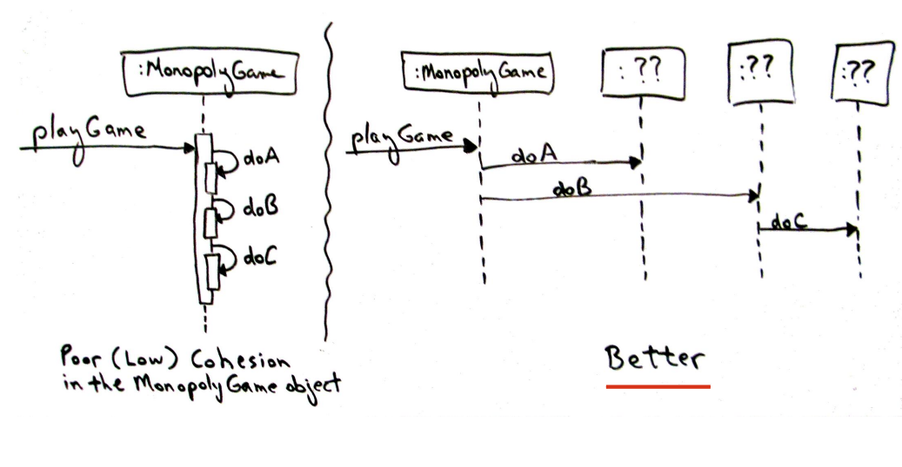

Slide 24

Polymorphism…

Slide 25
Polymorphism…
Intent:
When related alternatives vary by type, assign responsibilities for the behavior – using polymorphic operations – to types for which the behavior varies
BUT, do not test for the type of an object and use conditional logic to choose alternative.

Slide 26
…Polymorphism
Problem:
How to handle alternatives based on type? How to create pluggable software components?
If a program uses conditional logic to choose, if a new variation arises it requires modification to the logic
Notes:
According to the Polymorphism pattern, responsibility of defining the variation of behaviors based on type is assigned to the types for which this variation happens
polymorphism is a programming language feature that allows values of different data types to be handled using a uniform interface

Slide 27
Polymorphism – Example…
In POS app, who should be responsible for authorizing different kinds of payments?
We can take cash, check, credit or ATM payments and the authorize operation is different for each.
By Polymorphism, we assign responsibility to each payment type (inherit interface from abstract Payment class)

Slide 28
By Creator
By Polymorphism
Notes:
Creator: . Given two classes, class B and Class A, class B should be responsible for the creation of A if class B contains or compositely aggregates, records, closely uses or contains the initializing information for class A. It could then be stated that B is natural object to be a creator of A objects
Each payment type should authorize itself – by “Creator” sale initiates a :creditpayment and :checkpayment and asks it to authorize itself by “polymorphism”
Post initiates sale (creator)
Definition: Since the behavior of authorize varies by the type of payment, by polymorphism we should assign the responsibility for authorizing to different payment objects.

Slide 29


Readings , Assignments, Project Tasks
Read:
Chapters 8, 9, 10, 11, 12, 13 of the textbook.
Assignments & Project Tasks:
Project Deliverable 2 is due next Wednesday. This is a Team Submission.

Slide 30

Questions?

